Slide 1
SEC555
SIEM and Tactical Analytics
The Many Paths to Cybersecurity
Scott Lynch, SEC555 Instructor
@PacketEngineer

Slide 2
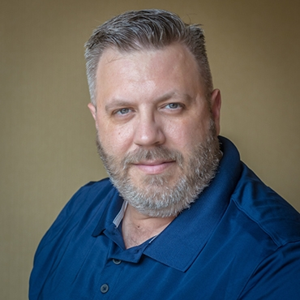



About Me
Scott Lynch
SEC555 SIEM and Tactical Analytics Instructor
US Navy Veteran, Electronic Warfare/IW
Cisco Instructor, CCNP-S, GCDA, GNFA, GCIH, GDSA
Manager Security Operations, Aerospace Company
Twitter: @PacketEngineer

Slide 3

The Problem
Issues organizations face today
Ransomware
Zero Day Exploit
Supply Chain Risks
Advanced Persistent Threat
Nation State
Hacktivism
Insider Threat

Slide 4
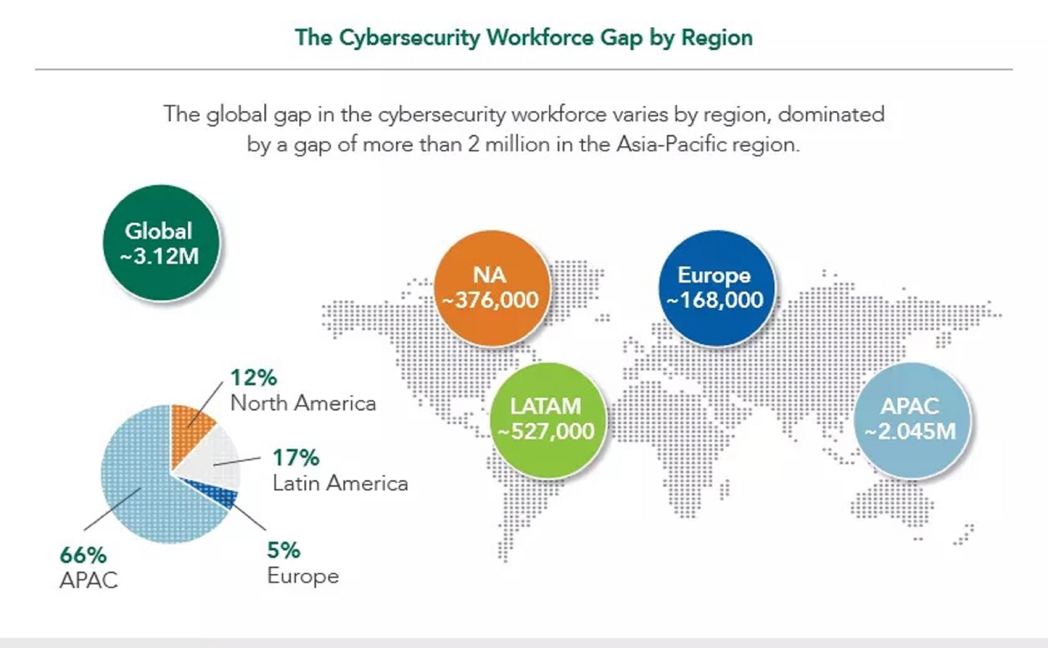
Cybersecurity Talent Shortage
Source: World Economic Forum (WEF) Report 2021

Slide 5
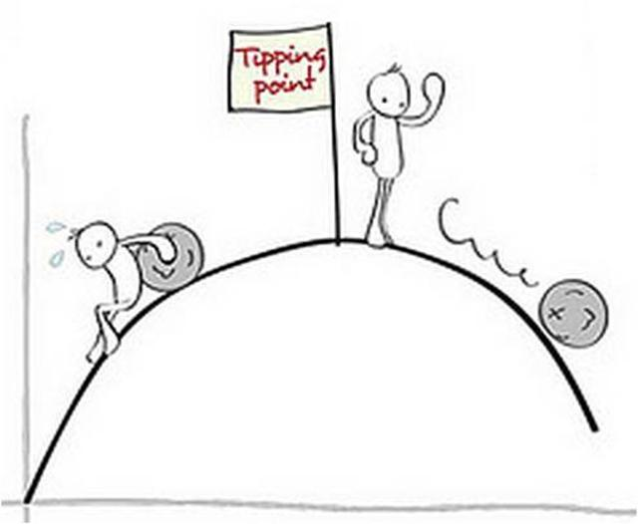
What's driving the trend
A general lack of qualified staff and candidates
Positions going unfilled
Prioritization of up-time
Large complex networks utilizing already thinly stretched IT personnel
Lack of security oversight
Failures or delays in security training for all employees

Slide 6

Many Paths Lead to a Carerer In Cybersecurity
Many Diverse paths to a cybersecurity job
College Students
Mid Career transition
Lateral Movement
Career Change

Slide 7

Path Diversity and Humble Beginnings
Examples
School Bus Driver
Chef
Accountant
Helpdesk
Military Veteran
Document Clerk
Automotive Repair Tech
Many Many More….

Slide 8

My Beginnings
Story: My first computer
Atari 400 PC

Slide 9

Exposure
Story: First Time I Installed Windows OS

Slide 10



Diving In
Story: IP In Space/UK-DMC
https://www.cisco.com/c/dam/en_us/solutions/industries/docs/gov/space_internet_nodes.pdf

Slide 11

Never Looked Back – Certifications and Training
Security Certified Network Professional (SCNP)
Cisco CCNA
Cisco CCNP-Security
Cisco CCAI Instructor
VMware VCP
SANS
30+ Trainings
5 Certs
SEC555 Instructor

Slide 12

Career Progression 20+ Years
Engineering Lab Technician
Ground Station Engineer
Ground Systems Engineer
Operations Analyst
Operations Integration Engineer
Network Engineer
Cisco Instructor
Network Manager
Security Operations Manager
SANS Instructor
Consultant

Slide 13
Webcasts and Vlogs
SANS Cyber Defense Channel
https://www.youtube.com/channel/UCCtOSdF1YCUeh_lsbPWIQoQ
Black Hills Information Security
https://www.youtube.com/c/BlackHillsInformationSecurity
Justin Henderson H&A Security Solutions
https://www.youtube.com/c/HASecuritySolutions
Defcon Blue Team Village
https://www.youtube.com/c/BlueTeamVillage/featured
David Bombal
https://www.youtube.com/c/DavidBombal

Slide 14
More to Explorer
Twitter
@PacketEngineer
Slack
Blackhills Information Security
Discord Groups
SANS Cyber Defense
Defcon Blue Team Village (BTV)

Slide 15
Summary
There are many paths to a career in cybersecurity
“Being with the end in Mind” Quote Stephen Covey
Start with a sheet of paper and make a plan
Do something!!!!
Participate in the community
Social Media
Vlog
Present at a conference

Slide 16
Questions
Questions

